Slide 1

Is EDR Alone Enough?
Why Do We Need XDR?
CYBERSECURITY INSIGHTS
EDR · XDR · Defense in Depth
Notes:
Good morning everyone, and thank you for joining. Today I want to answer a question I hear often from organizations: if we have EDR, are we protected? EDR has become one of the most popular security investments, and for good reason. But modern attacks rarely stay in one place. Over the next ten minutes, I'll explain what EDR does well, where its visibility ends, why XDR has become important, and how both fit into a bigger strategy called Defense in Depth. (About 30 seconds.)

Slide 2
Four questions in ten minutes
TODAY'S AGENDA
01
02
What does EDR do?
Is EDR alone enough?
03
04
Why do we need XDR?
How does it all fit together?
Is EDR Alone Enough? · 2
Notes:
Here is the plan. First, a quick look at what EDR actually does. Second, the honest answer to whether EDR alone is enough. Third, why XDR has become so important. And finally, how everything fits together in a layered security strategy. Whether you're new to cybersecurity or already working in a SOC, I hope you'll leave with a clearer picture of where each tool belongs. (About 30 seconds.)

Slide 3



What EDR does
01 · ENDPOINT DETECTION AND RESPONSE
A lightweight agent on each laptop, desktop, server and mobile device sends security telemetry to a central console.
Monitor
Detect
Respond
Processes, files, network connections and system events
Suspicious behavior and malware execution
Isolate devices, stop processes, investigate
Is EDR Alone Enough? · 3
Notes:
EDR stands for Endpoint Detection and Response. Endpoints are the devices connected to our environment: laptops, desktops, servers and mobile devices. EDR works through a lightweight agent installed on each device. That agent monitors activity such as processes, file changes and network connections, and sends it to a central console. From there, EDR detects suspicious behavior and lets the team respond, for example by isolating an infected laptop. One quick clarification: an EDR agent is not spyware. Its only purpose is legitimate security monitoring. And if a device temporarily loses connection, many products keep protecting it locally. (About 50 seconds.)

Slide 4
On-premises or cloud-based?
DEPLOYMENT MODELS
On-premises EDR
Cloud-based EDR
Servers in your own office or data center. Remote devices usually need a VPN.
Platform hosted by the vendor. Devices connect securely over the internet.
+ Direct control over data and infrastructure
+ Less overhead, easier scaling
− You run hardware, patching and backups
− Subscriptions, data residency, compliance
Is EDR Alone Enough? · 4
Notes:
EDR can be deployed in two main ways. On-premises means the management server sits in your own office or data center. You get direct control over the infrastructure and the data, but you also own the hardware, patching, backups and availability. Remote devices usually need a VPN to report in. Cloud-based EDR is hosted by the vendor. It's easier to scale and makes it simple to manage devices anywhere in the world. But it's not automatically cheaper. You still pay subscriptions, and you must think about data residency and compliance. The right choice depends on your requirements, regulations, team and budget. (About 50 seconds.)

Slide 5
No.
02 · IS EDR ALONE ENOUGH?
EDR sees the endpoint. Attacks move across email, identities, networks and the cloud.
What a security team cannot see, it cannot defend.
Notes:
So, is EDR alone enough? The honest answer is no. EDR is critical, but its visibility is limited to the devices it protects. Real attacks don't stay on one laptop. They arrive by email, steal identities, move across the network and reach into cloud services. When an incident happens, the security team needs to answer: where did the attack start? Which accounts were compromised? Which systems were accessed? How did the attacker move? EDR alone can't answer all of those questions. And what a security team cannot see, it cannot defend. (About 45 seconds.)

Slide 6
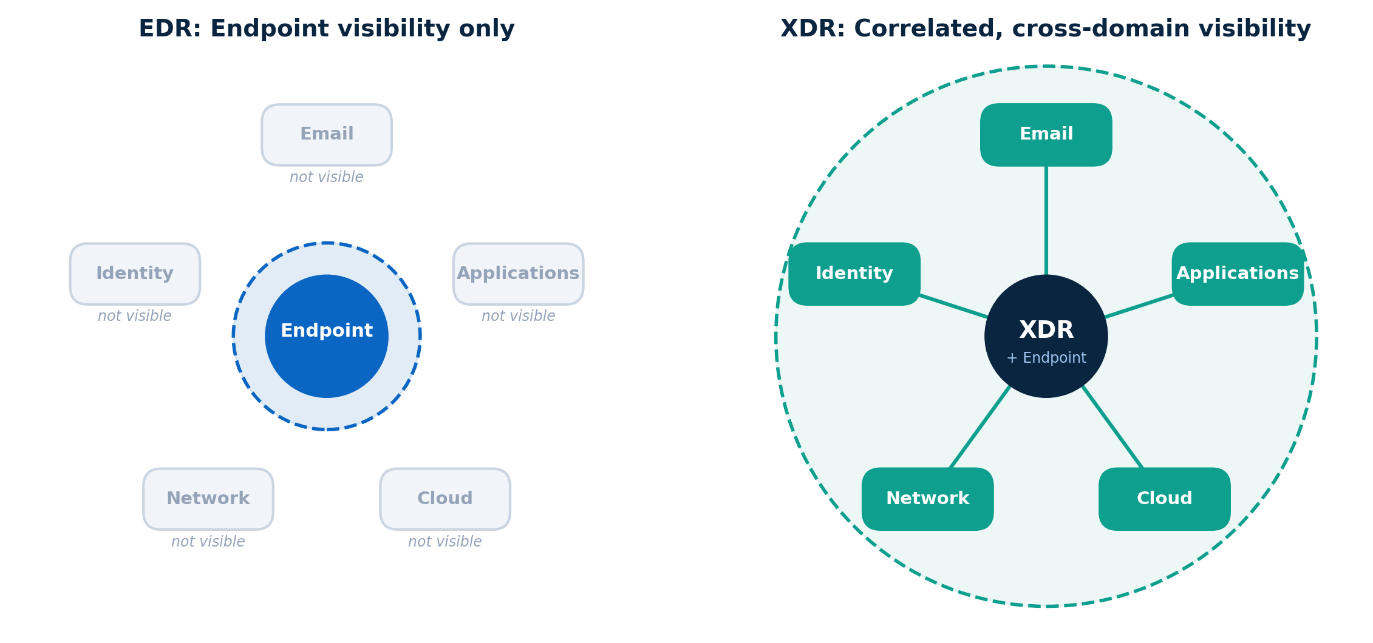
EDR sees one piece. XDR connects the story.
THE VISIBILITY GAP
Is EDR Alone Enough? · 6
Notes:
This picture sums up the problem. On the left is EDR. It has deep visibility into the endpoint, but email, identity, network, cloud and applications are outside its view. On the right is XDR. XDR keeps the endpoint data, but it also brings in data from all those other domains and connects the events together. Important point: XDR does not replace EDR. It extends visibility beyond the endpoint. (About 30 seconds.)

Slide 7
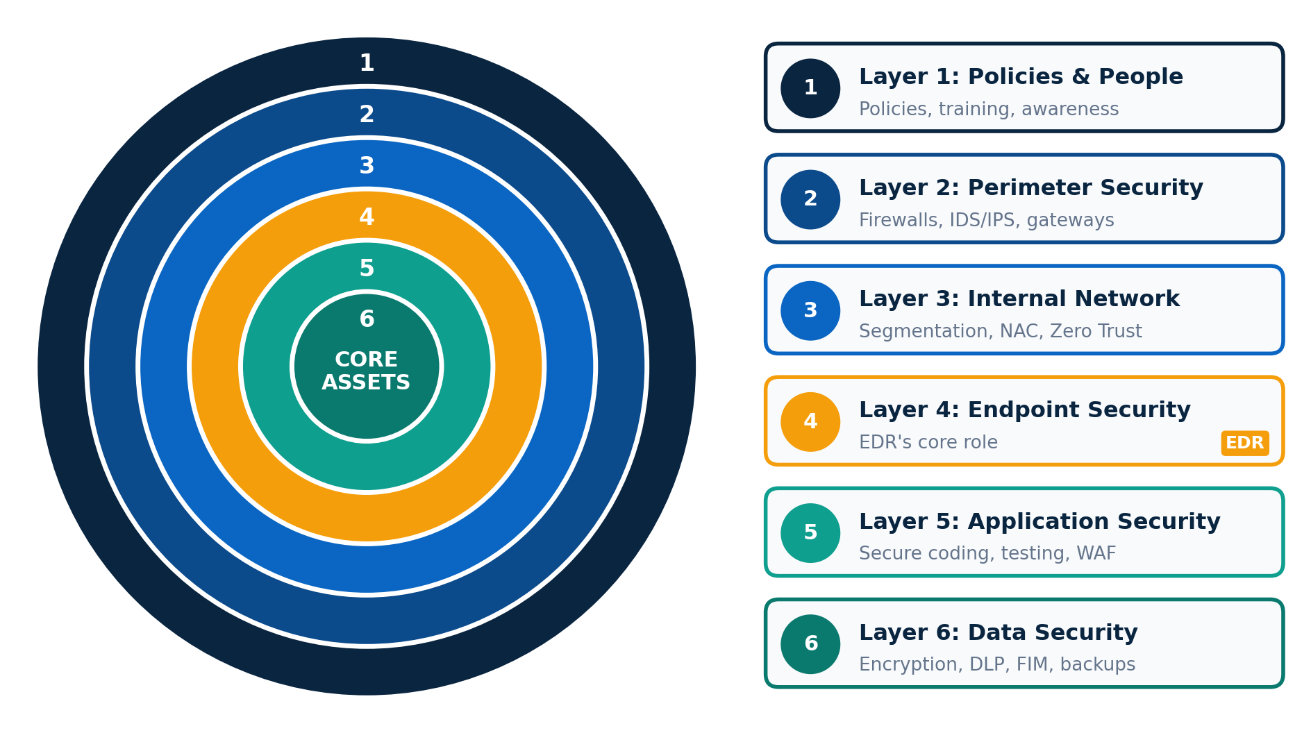
Security works in layers, like an onion
DEFENSE IN DEPTH
Is EDR Alone Enough? · 7
Notes:
This is where Defense in Depth comes in. Think of an onion with layers around the core. If one layer fails, the others still prevent, detect or limit the attack. Layer one is policies and people: training, awareness and clear procedures. Layer two is the perimeter: firewalls, IDS and IPS, and email gateways. Layer three is the internal network: segmentation and Zero Trust, so one compromised device can't reach everything. Layer four, in orange, is the endpoint. This is where EDR lives. Then application security, and finally data security: encryption, DLP and backups. Notice that EDR is just one of six layers. This is an illustrative model, and organizations may structure it differently. (About 60 seconds.)

Slide 8
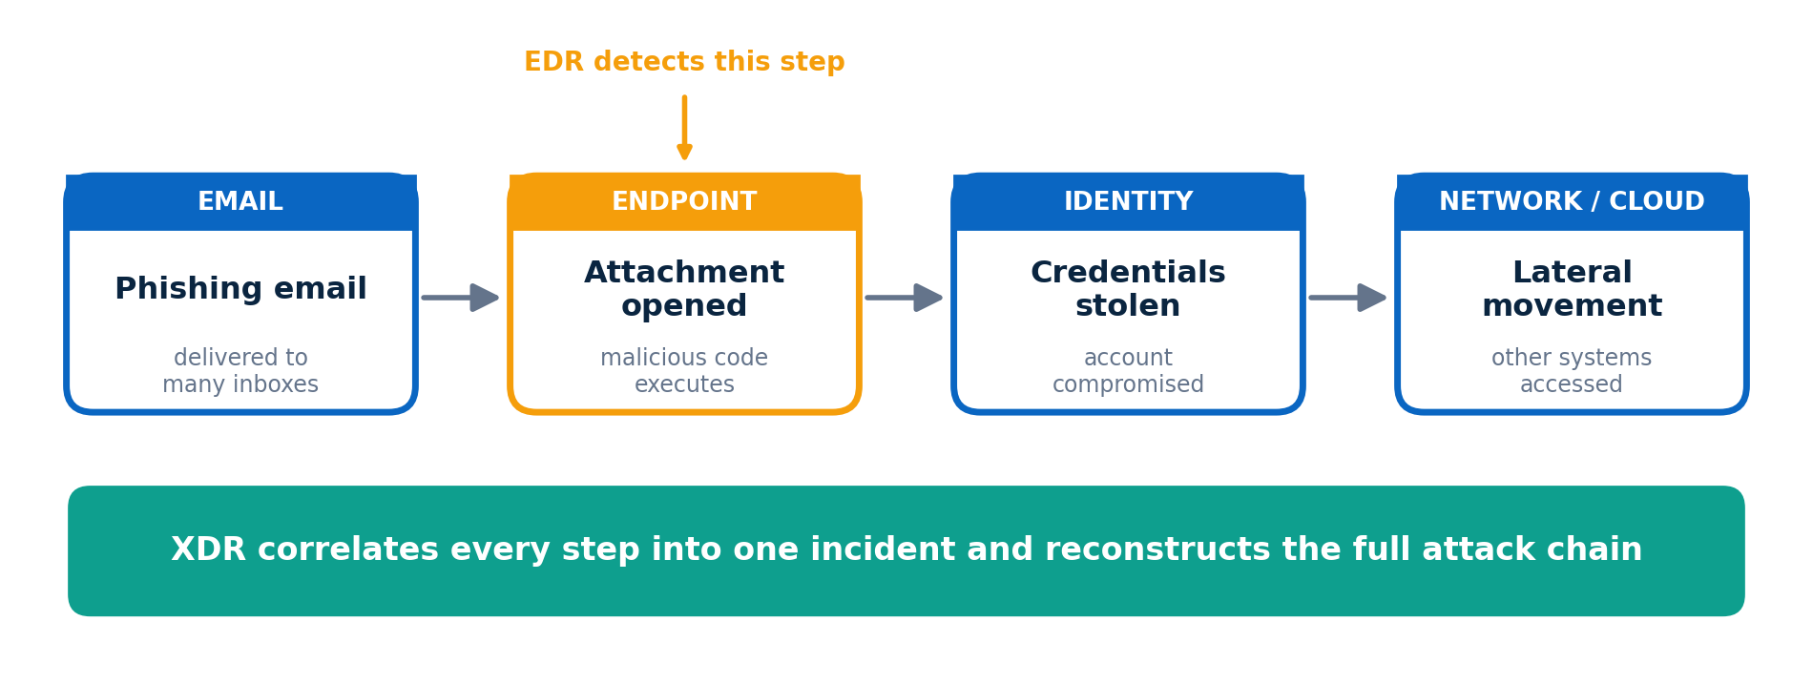
A phishing attack, seen two ways
03 · EXTENDED DETECTION AND RESPONSE
Is EDR Alone Enough? · 8
Notes:
Let's make XDR concrete with a phishing attack. A malicious email lands in several inboxes. One employee opens the attachment, and the malicious code runs. This is the step EDR catches, highlighted in orange. But the attack doesn't stop there. Credentials are stolen, an account is compromised, and the attacker moves to other systems. EDR alone can't tell us whether other employees got the same email, or whether the attacker used the stolen account elsewhere. XDR correlates email, endpoint, identity and network events into one incident, so analysts see the whole attack chain. One caveat: XDR only sees what is connected to it, so integrations matter. (About 60 seconds.)

Slide 9




Four key benefits of XDR
WHAT XDR ADDS
Cross-layer visibility
Event correlation
One view across endpoint, email, identity, network and cloud
Related alerts become one incident, not many
Automated response
Less complexity
Isolate devices or disable accounts faster, if tuned carefully
Fewer consoles to switch between during an incident
Is EDR Alone Enough? · 9
Notes:
XDR brings four main benefits. First, cross-layer visibility: one view across endpoints, email, identities, networks and cloud. Second, correlation: instead of investigating dozens of separate alerts, analysts see related events as a single incident. Third, automated response: XDR can isolate a device or disable a compromised account quickly. But automation needs careful tuning, because a false positive can disrupt the business. Fourth, less operational complexity: analysts don't have to jump between many consoles. Still, XDR doesn't remove the need for every other tool. Some specialized solutions remain necessary. (About 50 seconds.)

Slide 10



XDR has challenges too
TRADE-OFFS
Vendor lock-in
Integration limits
Cost and licensing
Easy inside one ecosystem, harder to leave. Check portability and exit terms.
Third-party tools may share limited data. Verify before you buy.
Tiers, data limits and add-ons. Judge total cost of ownership.
Is EDR Alone Enough? · 10
Notes:
XDR is not magic, and it has trade-offs. First, vendor lock-in. It's like the Apple ecosystem: an iPhone, iPad and Apple Watch work beautifully together, but switching away is hard. Before committing, check interoperability, data portability and exit terms. Second, integration limits. Some third-party tools share only limited data or support limited response actions, so verify the integrations you need before you buy. Third, cost and licensing. Look beyond the first price at licensing tiers, data ingestion limits and add-ons. Saving money is fine, as long as it doesn't create security gaps. (About 50 seconds.)

Slide 11
“A snail that tries to imitate a frog’s leap may end up stranded in the pond.”
A BURMESE PROVERB
Don’t follow security trends blindly. Decide based on your own risks, priorities and resources.
Notes:
I want to share a Burmese proverb: a snail that tries to imitate a frog's leap may end up stranded in the pond. In cybersecurity, this happens when organizations buy whatever is popular without assessing their own needs. Assuming EDR alone protects everything, or that a firewall alone secures every application, leaves gaps. Security decisions should be based on risk assessments, business priorities, existing capabilities and available resources, not on trends. (About 30 seconds.)

Slide 12



Real security needs all three
04 · BRINGING IT TOGETHER
+
+
Technology
People
Strategy
EDR, XDR and layered controls
Skilled engineers and analysts
Defense in Depth, based on risk
Cybersecurity can't be bought off the shelf. Neither EDR nor XDR is a complete solution on its own.
Is EDR Alone Enough? · 12
Notes:
To bring it all together: cybersecurity can't be achieved simply by buying and deploying products. EDR is critical for endpoint protection. XDR improves visibility, correlation and coordinated response across domains. But neither is a complete solution on its own. Real security needs three things. Technology: the right controls across every layer. People: skilled professionals who configure the tools, investigate alerts and respond. Organizations should also clearly define the different but complementary roles of Cybersecurity Engineers and Cybersecurity Analysts. And strategy: a Defense in Depth approach based on real risk, with continuous monitoring and improvement. (About 50 seconds.)

Slide 13
Thank you
Questions and discussion
[Presenter name] · [LinkedIn / contact]
Notes:
Thank you for your time. I hope this helps, whether you're beginning your cybersecurity journey or strengthening your understanding of EDR, XDR and Defense in Depth. I'm happy to take any questions. (About 15 seconds, then Q and A.)

